Slide 1
Location recommender system for opening a new restaurant in Brooklyn
Capstone Project - The Battle of Neighborhoods
Project Presentation
by Samuel I

Slide 2
Problem Statement and Idea
A chef wants to open his own restaurant in Brooklyn, New York City. He wants to know the best area to open a restaurant by analyzing different neighborhoods.
Therefore, solution for this problem is to create a machine learning recommender system which will help the chef to make better and informed decision on best areas to open the restaurant

Slide 3
Data Used
Four-square API : To get location details like Venue Name, Catagory, customer likes, etc.
New York City GeoJson data

Slide 4
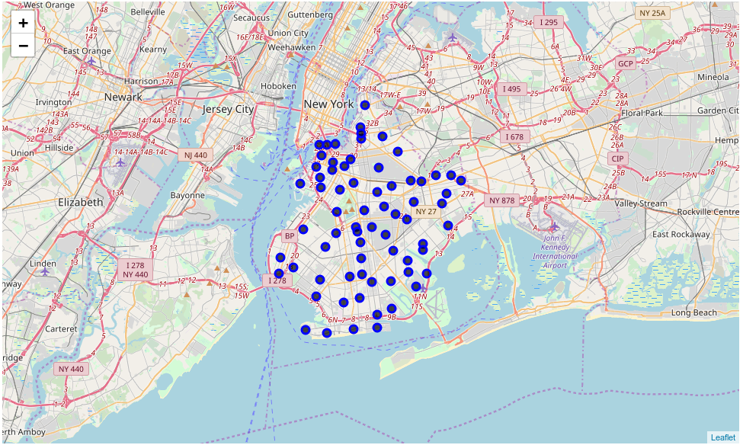
Analysis
Location of all the neighborhoods only in Brooklyn

Slide 5
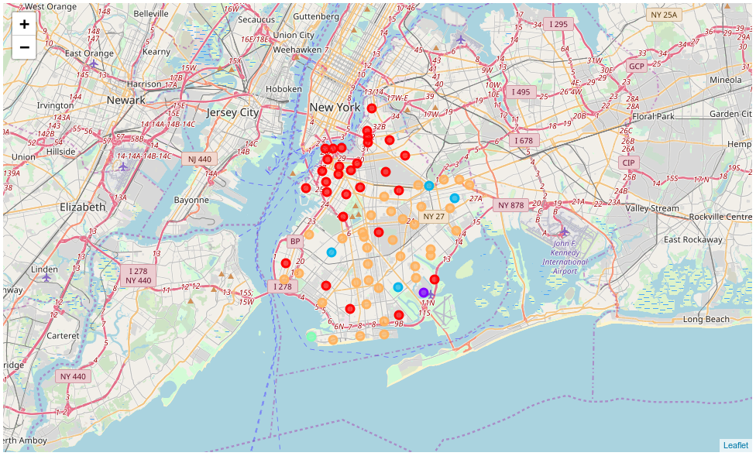
Location of all the venues optained by Foursquare API excluding all the restaurants in the neighborhood
With the help of K-means clustering technique we can cluster the data into 5 groups with most common restaurants and other venues

Slide 6
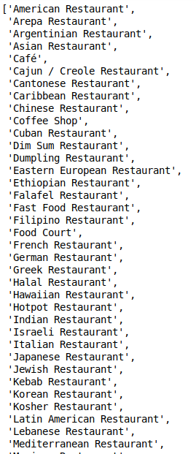
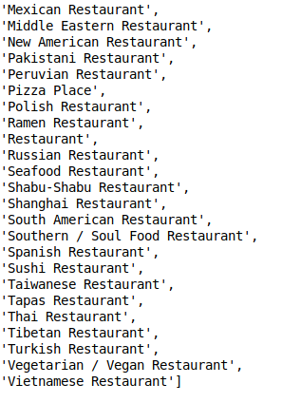
Types of restaurant located in Brooklyn

Slide 7
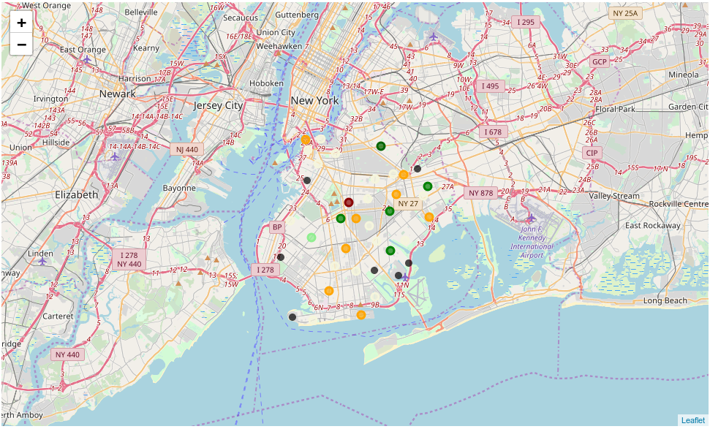
Assume if we want to open a Indian Restaurant
Location where Indian Restaurant is most commonly located

Slide 8
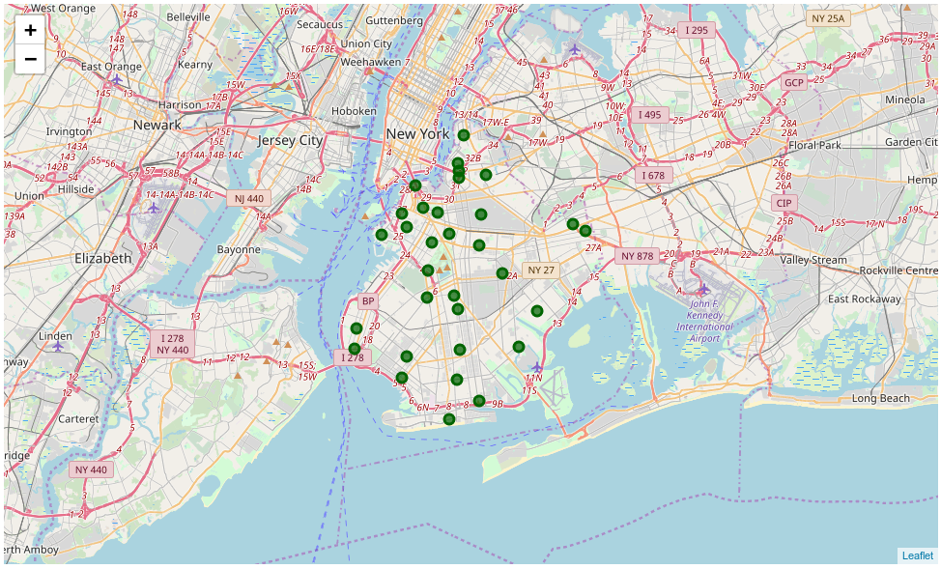
These are the place where Indian restaurants are NOT commonly located.
Result : Above mentioned locations are some of the area to start your restaurant.

Slide 9
Discussion
The clustering provides an insight of the similarities in different neighborhoods in Brooklyn by analyzing different restaurants and other venues.
This project finds the best location only by comparing the restaurant type which are already present in Brooklyn. But if some people wants to open a totally different restaurant type which is not already present in Brooklyn then as a business tactic any neighborhood would be a best choice to open the restaurant

Slide 10
Conclusion
With this analysis we can conclude that using the location data from Foresquare along with Machine Learning algorithms like K-means clustering we can design a system that will help to guide small business owners to make informative decision on which is the best neighborhood to a new restaurant.

